Slide 1
Major Project Defense
INTERNET BASED SERVICES OVER SMS AND VOICE CALL FOR GSM FEATURE PHONES.
Presented by-
Nishant Nischaya - 03314802816 Nikhil Prakash - 03214802816 Pratham Chhabra – 03614802816
Under the guidance of-
Ms. Abhilasha Gokhale

Slide 2
Statistics
According to a 2018 survey, 62% of the people of India own at least one mobile phone. Out of this population, surprisingly 61% of the people are using a basic feature phone which does not have internet access facility. Most of this demo-graph consists of rural population, urban poor population, farmers (SEC B and SEC C households) and students of tier-II and tier-III cities.
India Ranks 40th in Smart-phone penetration in a list of 50 nations with only 27.7% percentage of population owning a smart-phone.
In December 2019, India's rank was declared as 128th in a list of 140 countries in mobile data download speed by Ookla.
Average speed recorded was 11.46 Mbps whereas the global average was 32.01 Mbps.

Slide 3
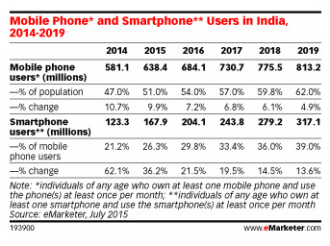

Slide 4
GSM vs GPRS (How Mobile Internet works?)
GSM stands for Global System for Mobile Communication. GSM is nothing but the digital mobile telephony system which is widely used in all over the world.
It uses circuit-switching technique.
GSM is standard bearer of 2G technologies.
In GSM location area concept is used. It’s infrastructural cost is lesser.
It is more widely available then GPRS networks.
GPRS stands for General Packet Radio Service. It uses packet-switched data technique instead of circuit switching, and this technique makes much more efficient use of the available capacity.
GPRS is a huge upgrade over the basic GSM features. It allow the mobile handset to obtain much higher data speed than what standard GSM can offers.
In GPRS routing area concept is used. The infrastructural cost is higher than standard GSM.

Slide 5
CIRCUIT SWITCHING VS PACKET SWITCHING
Circuit – Switching | Packet – Switching
It is a connection oriented network switching technique. | It is a connection-less network switching technique.
A dedicated path has to be established between the source and the destination before transfer of data commences. Once, the data is transmitted, the path is relinquished. | There is no need to establish a dedicated path from the source to the destination.
It is inflexible in nature since data packets are routed along the same dedicated path. | Each packet is routed separately. Consequently, it is flexible in nature where the different data packets follow different paths.
It was initially designed for voice transfer. | It was initially designed for data transfer.
The entire message is received in the order sent by the source. | The individual packets of the message are received out of order and so need to be reassembled at the destination.
It is implemented at Physical Layer. | It is implemented at Network Layer.
It is not a store and forward transmission. | It is store and forward transmission.
Data is processed and transmitted at the source only. | Data is processed and transmitted, not only at the source but at each switching station.

Slide 6
Components Used
ATmega328: The high-performance Microchip 8-bit AVR RISC-based microcontroller combines 32KB ISP flash memory with read-while-write capabilities, 1KB EEPROM, 2KB SRAM, 23 general purpose I/O lines, 32 general purpose working regist, three flexersible timer/counters with compare modes, internal and external interrupts,serial programmable USART, a byte-oriented 2-wire serial interface, SPI serial port, 6-channel 10-bit A/D converter (8-channels in TQFP and QFN/MLF packages), programmable watchdog timer with internal oscillator, and five software selectable power saving modes. The device operates between 1.8-5.5 volts.
Raspberry Pi 3B+: The Raspberry Pi 3 Model B is a tiny credit card size computer that was designed in the UK by the Raspberry Pi Foundation.
GSM Modem SIM900A: It is built with Dual-Band GSM/GPRS engine- SIM900A works on frequencies 900/ 1800 MHz. The Modem is coming with RS232 interface, which allows you connect PC as well as a microcontroller with RS232 Chip(MAX232). The baud rate is configurable from 9600-115200 through AT command.
LCD DISPLAY MODULE: The 16×2 LCD display is a very basic module commonly used in DIYs and circuits. The 16×2 translates to a display 16 characters per line in 2 such lines. In this LCD each character is displayed in a 5×7 pixel matrix.

Slide 7
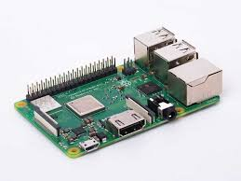
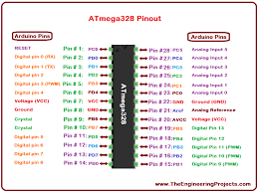
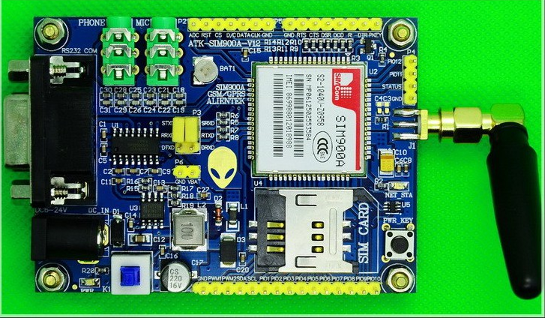
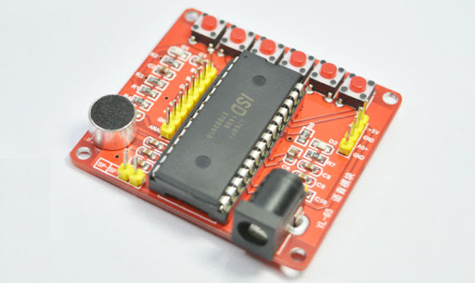
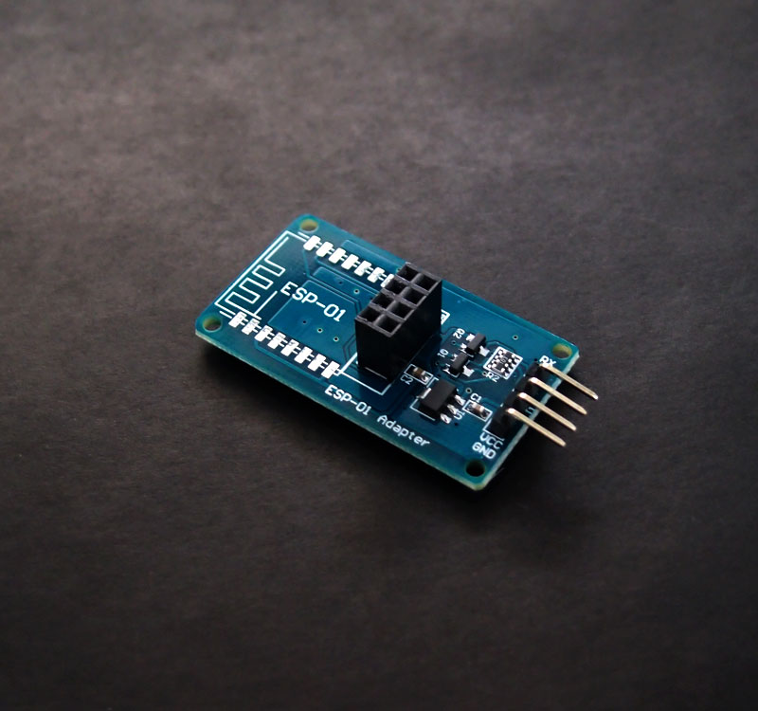
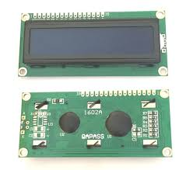
ATMega328P
SIM900A Module
Voice Recorder Module
Raspberry Pi 3B
ESP8266 WI-FI Module
16x2 LCD screen
Voice Recorder Module: The Voice module board is based on ISD18B20, which is a single-chip single-message record/playback device. Recordings are stored into on-chip non-volatile memory, providing zero-power message storage. With the embedded Flash memory employed, data retention up to 100 years and typical 100,000 erase/record cycles can be reached. Time for recording is 8-20 seconds.
USB to TTL converter: The so-called USB to TTL converter is actually a USB Serial Port to CMOS Logic-Level Serial Port converter. It has two ends: a USB connector, and four wires made to attach to terminal posts. It contains a chip that's able to trick your laptop into thinking a serial port is installed.
Wifi Module: The ESP8266 is a low-cost Wi-Fi microchip, with a full TCP/IP stack and microcontroller capability.

Slide 8
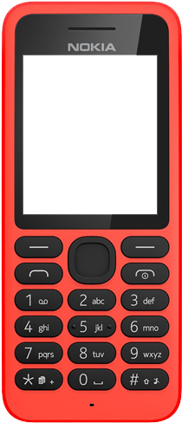
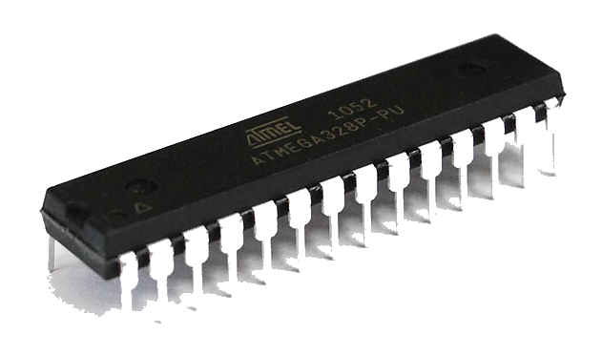
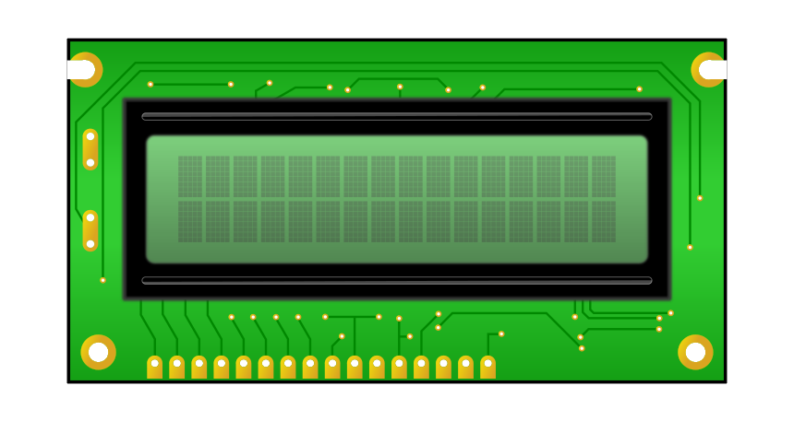
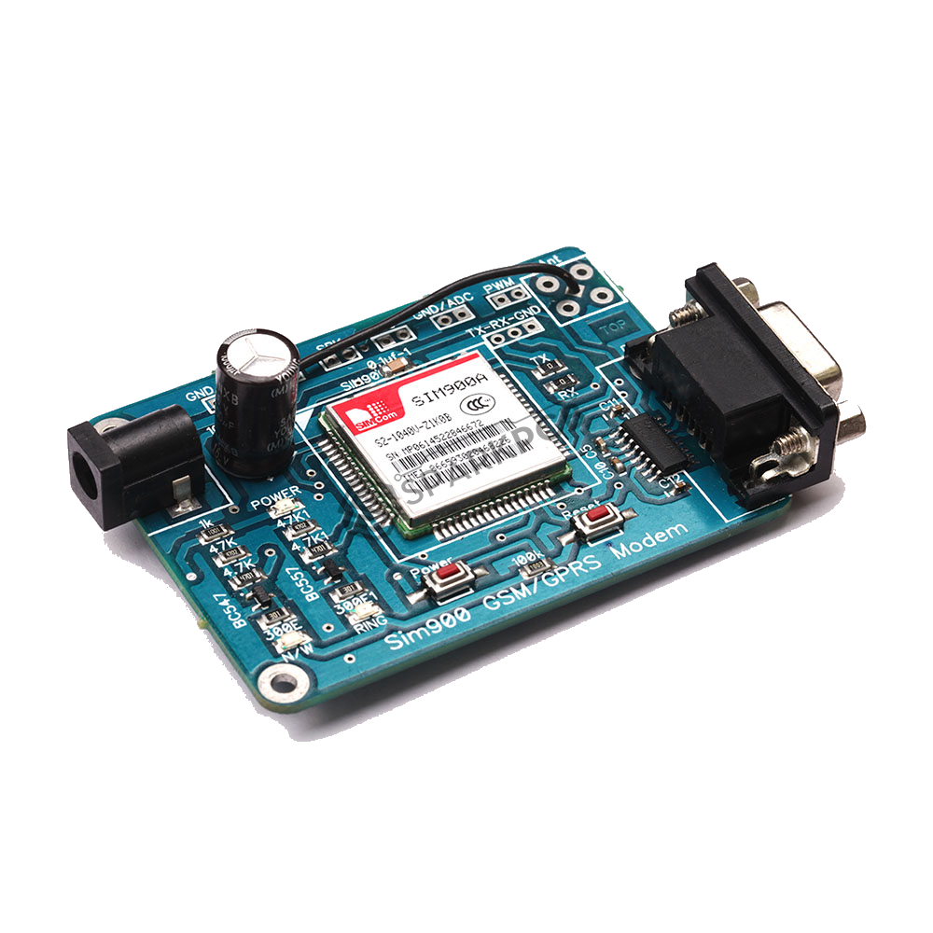
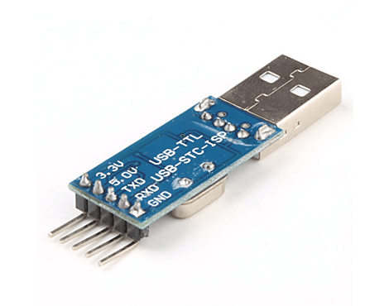
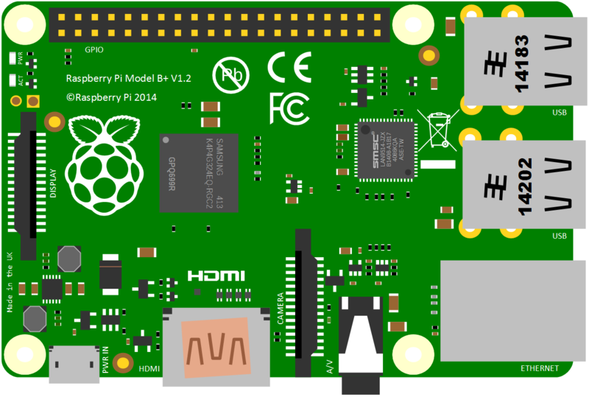
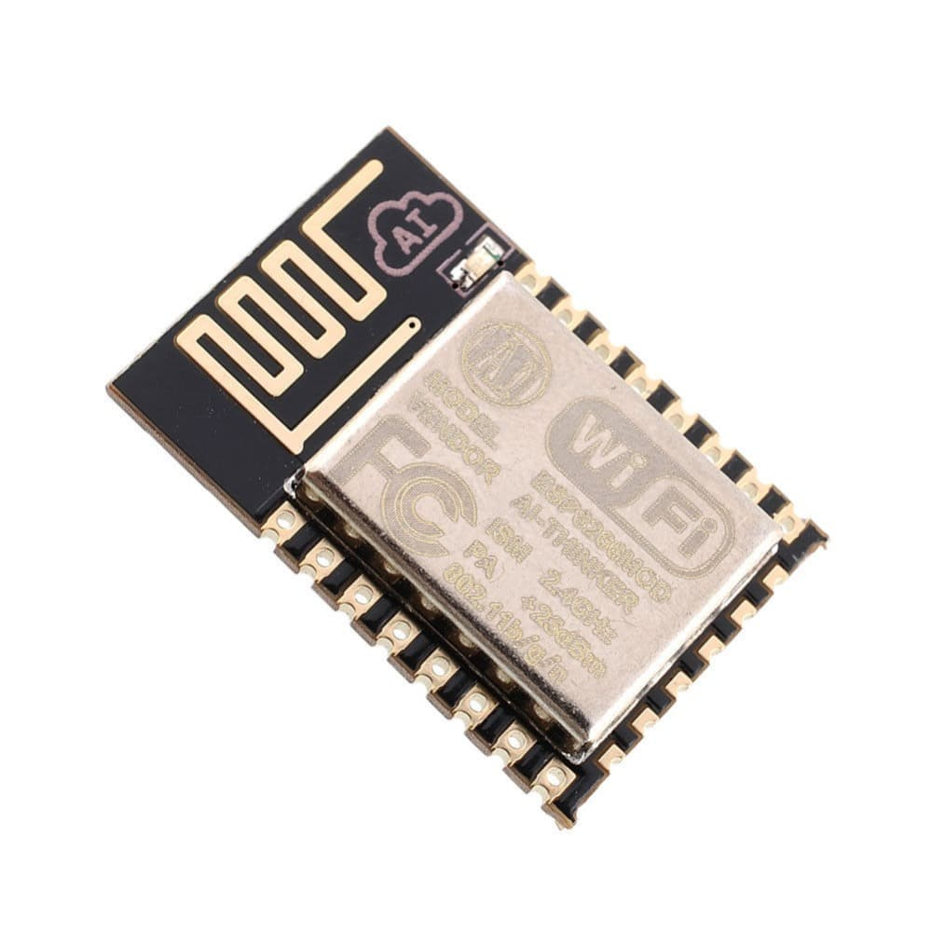
Block Diagram
16X2 LCD
Shows current status of Queue.
Shows incoming requests.
Client Device
ATMEGA 328P
Sends and Receives SMS data.
Sends AT commands to SIM900A.
Segregates the query on the basis of query type.
SIM900A
Mode is set using AT Commands.
Sends and receives SMS at Server-side.
Give Audio in/out ports for
voice calls.
OR
Raspberry Pi 3b+
Runs API.
Runs Voice Assistant

Slide 9
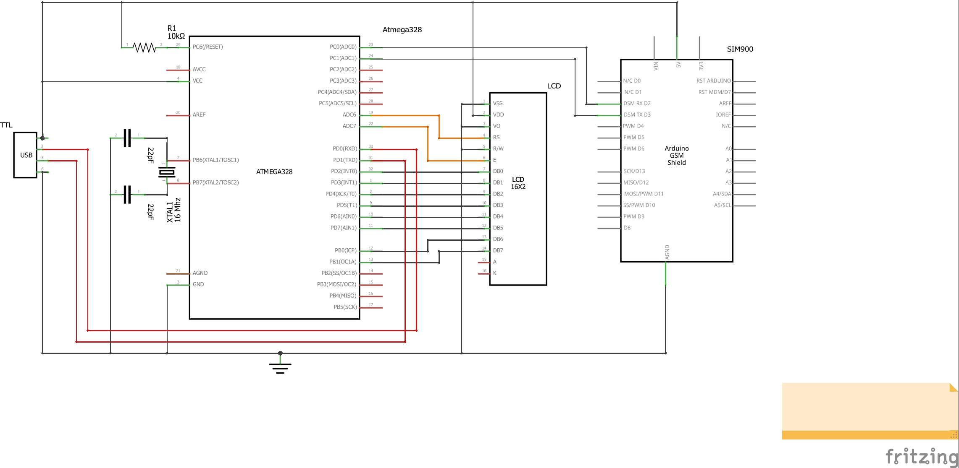
Schematic

Slide 10
Project Workflow
The voice call or SMS is forwarded via the circuit switched network to the server’s SIM900A module.
The SIM900A module is configured to handle Voice calls or SMS using required AT commands. AT commands are sent by the Atmega328p Micro-controller.
If transmission type is ‘Voice call’ then data is introduced to a voice recorder module to deal with input/output lag.
If transmission type is SMS then data is simple forwarded to Atmega328p.
After that data is processed to retrieve “query type” and “keyword”.
The query is resolved using APIs running on the raspberry Pi.
In case of voice call, Google Assistant is used as API and response is directly stored on the voice recorder module.
The response is then sent back to the requesting phone using GSM transmission for which AT commands are used.

Slide 11
Additional Features
Voice Assistant- Google Assistant or Alexa assisted voice call query resolution.
Markdown webpage - Markdown is a lightweight markup language with plain-text-formatting syntax. Its design allows it to be converted to many output formats, but the original tool by the same name only supports HTML. For smartphones our project can convert SMS into Markdown webpages.
Request Queue- For multiple requests, a request queue will be maintained on FIFO principle. Status of queue will be displayed on LCD screen.
Image Transfer- Base 64 format can be used in form of SMS to transfer images to the client.

Slide 12


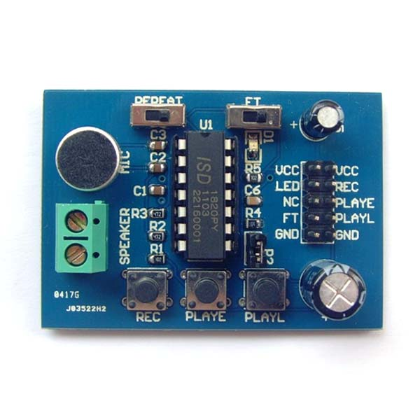
Voice Assistant Block Diagram
Works as
Input Buffer
Receive Incoming Call
Runs APIs
Makes voice call query
Voice Assistant
Raspberry PI 3B
SIM900A and ATmega328P
Voice Recorder Module
GSM phone

Slide 13
THANK YOU!
References
NPREF https://www.nperf.com/en/map/IN//1639.Airtel/download/?ll=15.572244602734123&lg=82.08105415105821&zoom=5
OOKLA INTERNET DATA SPEED RECORDS
WWW.EMARKETRS.COM
NEWZOO'S GLOBAL MOBILEMARKET REPORT
www.electronicsforu.com
www.sparkfun.com
www.researchdesignlab.com
www.rhydolabz.com
www.rasberrypi.org
www.tutorialspoint.com
www.iotdunia.com

